Slide 1
Internal Communications
SIMON OUELLETTE

Slide 2
Presentation Plan
Homework review.
What is internal communications?
Why should you care
What it can do for you
Misconceptions
How we can do this
One on one conversation
Some useful tools
How to prevent your communications from being “gimmicky”
An inspiring story : Teachers in West Virginia

Slide 3
What are internal communications?
Bulletin board posters sure fires me up! Said no one ever.
Emails are nice but…

Slide 4
Why should you care?
To break the mandate, we need strong internal communications
Boost morale and participation
Bust myths
We don’t have the money
We can’t pull it off
Fighting anti-union propaganda. Look at what employer are saying about communications : https://www.linkedin.com/pulse/how-unions-organizing-your-employees-social-media-right-orechwa

Slide 5
Misconceptions and obstacles
Misconceptions
Good communications is all we need to win!
I just need to set up a facebook group
« We already have a PR committee »
« Our members are already informed, we have radio ads and newspaper ads all over the place »
Obstacles
We have difficulty with quorum
My members are not engaged
My members don’t have time
Young people are not engaged

Slide 6
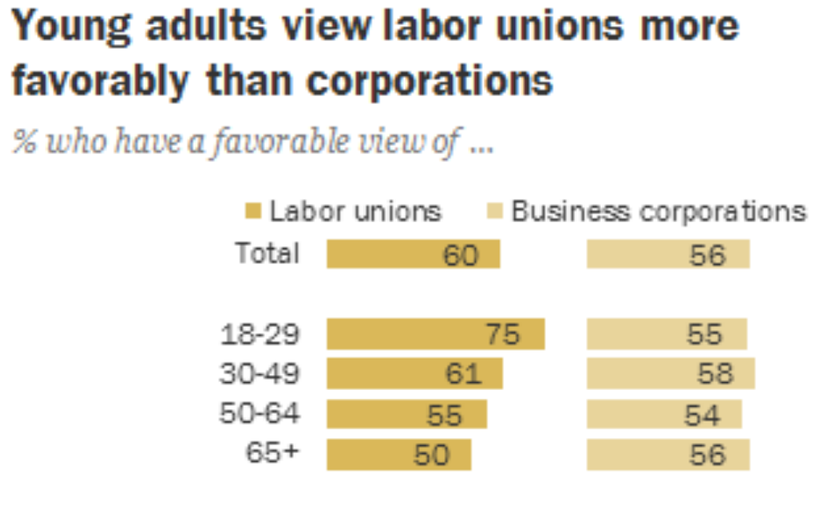
Not a myth!
http://www.pewresearch.org/fact-tank/2017/01/30/most-americans-see-labor-unions-corporations-favorably/ft_17-01-27_unionscorporations_demographics/

Slide 7
There is a trend : Unions are getting more attention in the last few years
https://www.teenvogue.com/story/what-a-labor-union-is-and-how-it-works

Slide 8
Making internal communications work
« If we are to break this mandate, we have to be rowing in the same direction »

Slide 9
The communications team and the Vision
Envision, get a strategy & plan
What do you want internal communications to do for your local and your union? How will you get there? Where does it stand right now, and what needs improvement? How soon would you like to reach your goals?
Setting up a team
Thinkers
Motivators
Organizers
Leaders
Doers*
Provide channels for feedback and ideas!

Slide 10
CHOOSING ACTIONS THAT FIT

Slide 11
Bombard the boss with phone calls and emails
Wear T-shirts or hats with a slogan or cartoon on a particular day
Put up posters
Hold an informational picket line
Strike
File a group grievance with signatures
Wear buttons or stickers
Distribute Leaflets
Set up a Facebook page for your campaign
Work to rule
Visit the boss in a small group
Spill the beans to the media
Do a survey
Circulate a petition
Do some “creative actions” at a government meeting
Rally in the parking lot and enter the building at the same time
Barrage management with tweets and Facebook comments
Write and sing a song about the boss
Everyone gets “sick” on the same day
Meet with outside supporters; get them to take action, too
Make up wallet cards that define workers’ rights
All take breaks at the same time
Visit the boss in a large group
Rally at headquarters or another targets

Slide 12
WHAT ARE THE OPTICS OF THE TACTIC?
• Does the action relate to your issue?
• Will it increase the pressure on the decision-maker?
• Is it simple, Is it visible?
• Is it timed for effect?
• Is it new and different—or tried and true?
• Are enough people ready to do it?
• How will the public react? Will it unify members?
• How will management react?
• Could it backfire?
• Does it violate the law or the contract?
• If so, are you prepared for the consequences?
• Will it be fun?

Slide 13
Never forget the big picture

Slide 14
CAPTAIN CAMPAIGNS

Slide 15
Handout! One on one conversations

Slide 17
Says positive things about the Union on Facebook
Files a grievance
Runs for office
Not involved
Goes to a
meeting
Goes to union with a problem
Would do civil disobedience for the union
Goes on strike
Wears a button

Slide 18
Who is taking care of the new members? *Updating your members lists*

Slide 19
First you’ve got to get mad!
… Then channel that frustration in positive, empowering action.

Slide 20
Don’t just inform – inspire action

Slide 23
Some useful tools Cupe.ca, Lime Survey, MailChimp, Canva, CALM, etc.
HANDOUT!

Slide 25
It’s a question of attitude
Being positive and inclusive goes a long way
Look forward, don’t dwell too much on the past
Share the power and the responsibilities: let rank and file members organize social events once in a while
Perfect gets in the way of done. Don’t overthink everything

Slide 26
An inspiring story : Teachers in West Virginia
https://www.cnn.com/2018/02/26/us/iyw-striking-teachers-feed-students-trnd/index.html
https://www.usatoday.com/story/news/nation/2018/02/27/west-virginia-teachers-packed-lunches-their-needy-students-before-going-strike/377591002/
https://socialistproject.ca/2018/03/west-virginia-teachers-strike/

